Slide 1

＋
Chris Yazbek | UI•UX Developer / Consultant
13 ~ 15 of April 2018

Slide 2
Bluemix | Watson Conversation
NodeJS | Demo Project
Conversational User Interface
Watson API Overview
Kick Start Project
Agenda
＋

Slide 3
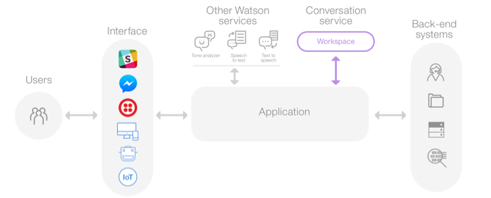
End2End
＋

Slide 4
Bluemix | Watson API
Go to IBM Cloud Bluemix and create an account (https://console.bluemix.net/)
Create a new resource
Select Conversation from the Watson platform
Rename as [Your-ProjectName-Conversation]
Create service
Launch tool ⌝
＋

Slide 5
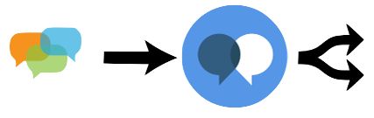


Watson Conversation
Intent
Entity
Chat Message
Watson Conversation
Split into Intents & Entities
Intent
present the purpose of the users input. Having variations of written statements with the same purposes, allows Watson to understand different linguistics of the language and creates a stronger understanding of an intent.
Entity
represents a class of objects or a data types that are relevant to a user's. By recognizing the entities that are mentioned in the user's input, the Conversation service can choose the specific actions to take to fulfill an intent. Entities are usually nouns but may be actions and are identified by exact string matches.
Dialog
is the rule based part of the system. A dialog tree represents the interaction(s) with the end user. You can create a branch to process each intent you define. NLC outputs the Intent and Entities, and Dialogue takes that as an input and then generates response to the user.
＋

Slide 6
https://github.com/watson-developer-cloud/conversation-simple
＋

Slide 7
Build & Run Simple Conversation Project
Clone repo | https://github.com/watson-developer-cloud/conversation-simple
Install NodeJS | https://nodejs.org/en/
Install Cloud Foundry CLI | https://github.com/cloudfoundry/cli#downloads
Configuring the app environment
Copy or rename the .env.example file to .env (nothing before the dot).
Get Workspace ID, Username & Password (Service Credentials before launching t)
Modify manifest.yml | Application:Name & Application:Services
cd into the repo’s directory and run the following commands :
> npm install
> npm start
Open browser:
http://localhost:3000
＋

Slide 8
Why code from scratch when you can Copy, Paste & Modify
Starter Kit
Goodies
Getting Started
Guide-Me
POST Request / Response
Watson-API
＋

Slide 9
＋
< Happy Hacking />

